Slide 1
Welcome to
Master Business Class

Slide 2
Start Your Own Business
Be Your Own Boss
Learn how to start and grow your own small online travel agent business
Turn your passion into a profitable business.

Slide 3
What Will I Learn?
How to set a online travel business up and get running.
How to market your products and close your sales.
How to grow and what comes next once you get going
Make a detailed list of what to sell, and how much to sell it for.
Make comprehensive budget so you will know how much money you can expect to make.
Know and understand how travel business organizations work in the global.
Have confidence when starting a small travel business

Slide 4
In this course:
Introduction To The online travel market.
Use Your Passions To Pick Your Path
(so you know what to do)
Pick and Price Your Products and Services
(so you know what to sell)
Business Organizations
(so you know how to setup)
Business Management
(so you know how to run your business)
Marketing and Sales
(so you know how to grow)
Growth and Next Steps
(so you know what's next)

Slide 5
Benefits of This Class:
You are going to learn and understand the insights about travel industry
End of this class, you are a owner of online travel website
After success end of this class, you will receive a paid task daily
Where you can work with us part time or freelance
You can work anywhere, any time as your schedule
We will share and create global audience to your own business
Performance based incentives, free training & Commission for your product uploaded in our online system
After successful complete the training you able to run your own show using our resources as well your idea.

Slide 6
List of 10 Biggest Industries in the World in 2021
1. Financial Services
(Market value: $22.5 trillion)
2. Construction
(Market value: $12.5 trillion)
3. Commercial Real Estate
(Market value: $9.6 trillion)
4. E-commerce
(Market value: $9.09 trillion)
5. Life and Health Insurance
(Market value: $8.45 trillion)
6. Information Technology
(Market value: $5 trillion)
7. Food Industry
(Market value: $5 trillion)
8. Oil and Gas E&P
(Market value: $4.6 trillion)
9. Automobile Manufacturing
(Market value: $3 trillion)
10. Telecommunication
(Market value: $1.74 trillion)

Slide 7
Where Global travel and tourism industry stand
Tourism made up 10 percent of global GDP in 2019 and was worth almost $9 trillion
Making the sector nearly three times larger than agriculture.
COVID-19 has caused an unprecedented crisis for the tourism industry.
The global travel and tourism industry has finally started to get back on its feet following the pandemic’s disastrous impact.
Global travel and tourism industry could grow to $8.6 trillion in 2023

Slide 8
What is the Global Tourism industry?
Tourism is defined as international visitors spending across national borders travel primarily for
Leisure
Business Travel
MICE

Slide 9
Tourism Types
Domestic
Inbound
Outbound
Visits within a country by visitors who are residents of that country.
Visits to a country by visitors who are not residents of that country
Visits by residents of a country outside that country

Slide 10
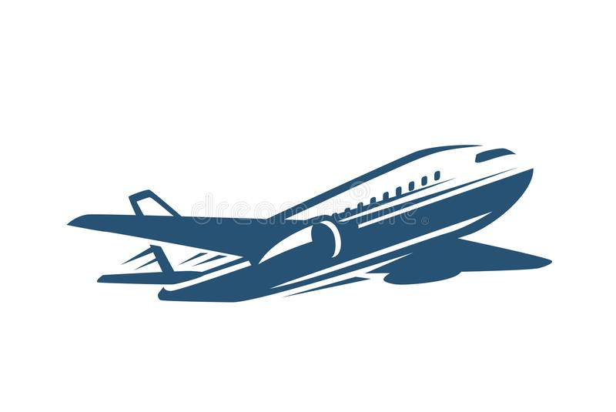
Industry Products and Services
Traveler
Accommodations
Air Transportation
Tours &
Activities
Ground
Transportation
Food and beverage

Slide 11
What is Travel Agency
an agency engaged in selling and arranging transportation, accommodations, tours, and trips for traveler
Travel Agency
Retail Travel Agents
Wholesale Travel Agents
Online Travel Agents (OTA)

Slide 12
Product & Services
Product Owner
Travel Agent
Agent
Distributor
Own
Website
Sub
Agent
Distributor
Own
Website

